Slide 1

Find best venues categories near metro entrances
IBM Data Science Professional Certificate
Applied Data Science Capstone
Eleonora Picca

Slide 2
Summary
Business Problem and Stakeholders
Data Set
Overall Strategy
Data Preparation
Choose best k
K-means clusters
Results
Recommendations
Conclusion

Slide 3
Business Problem and Stakeholders (1)
New York City is the third most congested city in the world in terms of traffic and the second worst in the United States.
The reasons behind traffic problems are various, but one of them is that lots of New Yorkers choose to go around city by car.
NYC Metropolitan Transportation Authority (MTA) needs a strategy to alleviating traffic.
If more New Yorkers used the subway:
Less cars would be on the road.
Gain would raise and it could be spent to pay for a major overhaul of the aging subway .

Slide 4
Business Problem and Stakeholders (2)
One solution could be to make agreements with venues near metro entrances in order to give special offers to New Yorkers who use the subway.

Slide 5
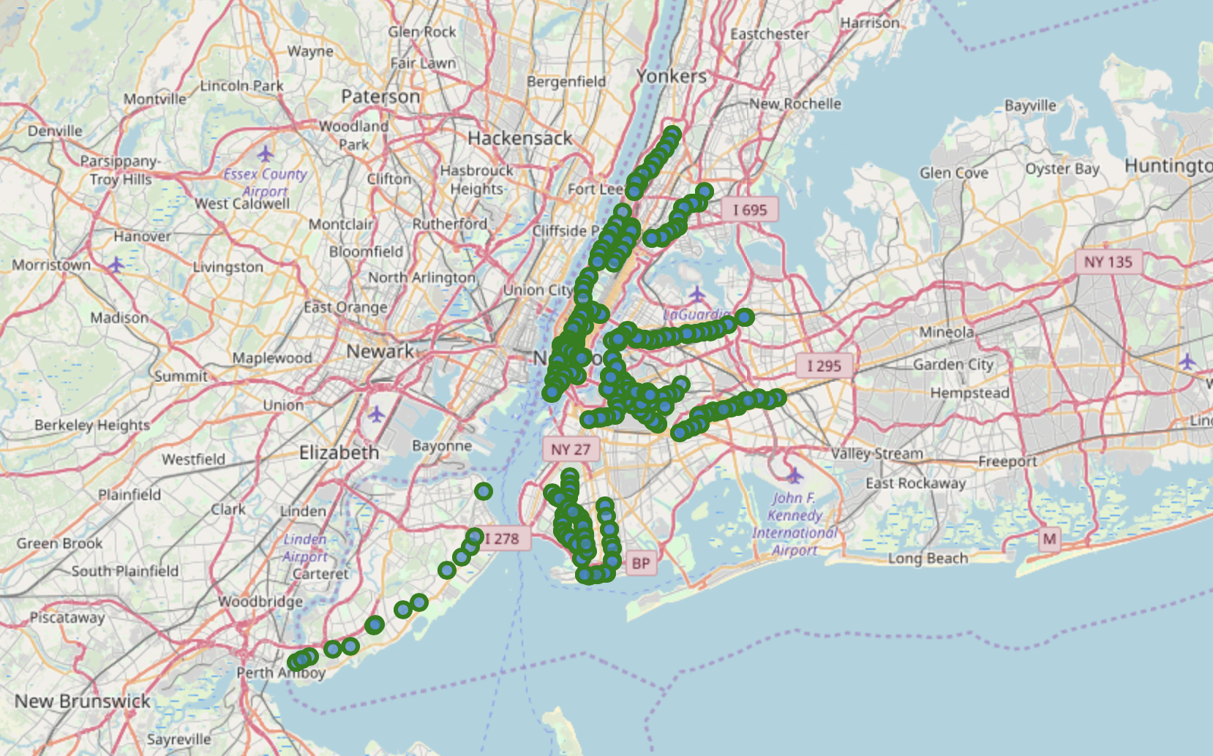
Data Set (1)
New York City subway entrances, with latitudes and longitudes. A 400 subset is selected.
Use Foursquare API “Explore” to have all the venues near the subway entrances:
Venues has to be near the metro entrance, in this case we chose a radius of 500 m.
Best venues are the one more popular, because they have more appeal.

Slide 6
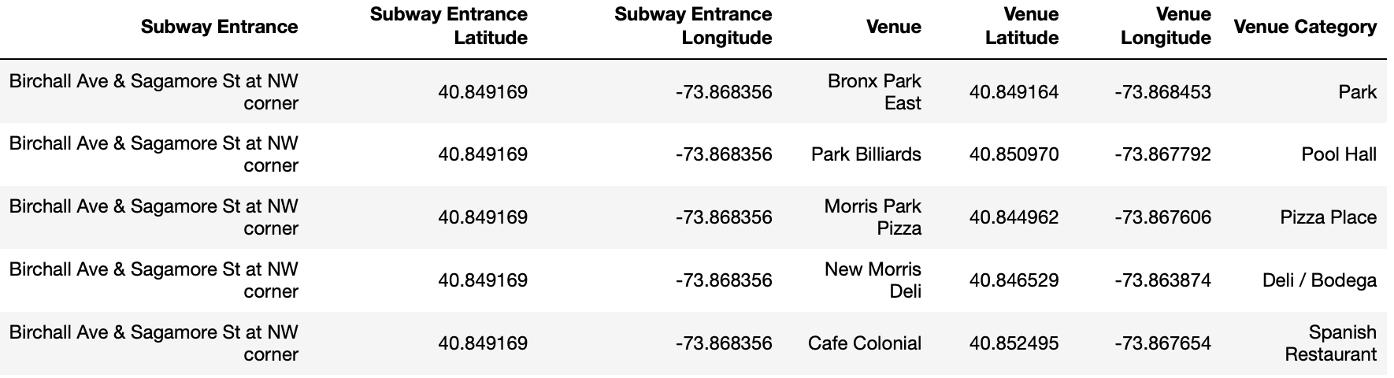
Data Set (2)
A subset of the final data set.
Venue Category will be used for characterize each venue entrance.

Slide 7
Overall Strategy
In order to create clusters based on venues categories, K-means algorithm can be used.
Data Preparation
Remove duplicates and transformation on subway entrances.
One-Hot encoding and calculate the average number of category types per each venue.
Choose best K
Elbow method.
Silhouette analysis.
K-means clusterization.

Slide 8
Data Preparation
In order to create clusters based on venues categories, K-means algorithm can be used.

Slide 9
Choose best k

Slide 10
K-means clusters

Slide 11
Results

